Slide 1
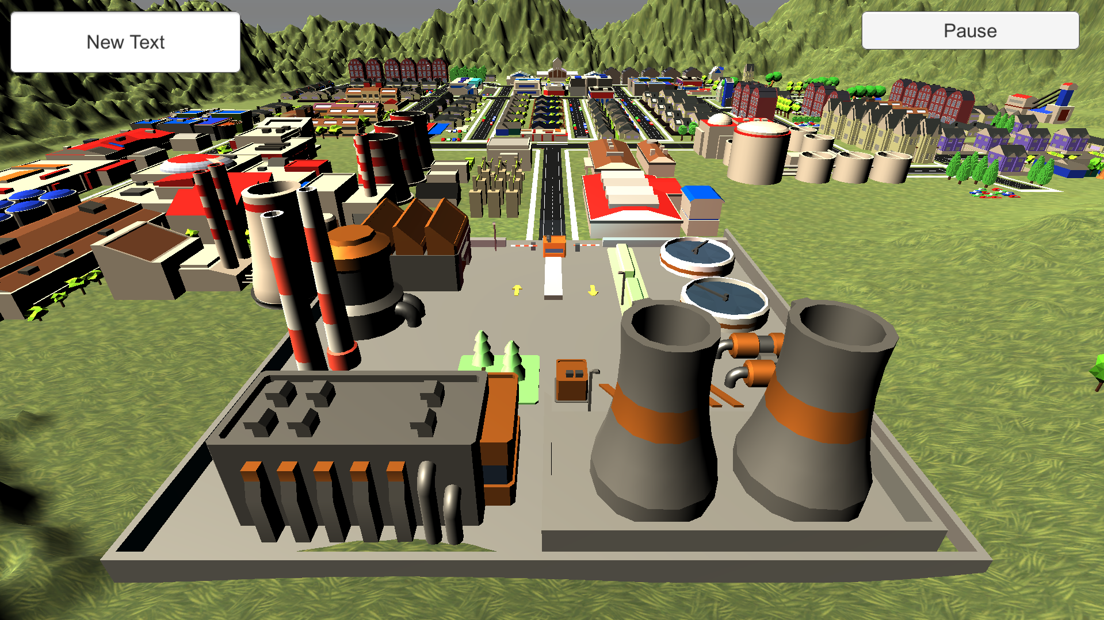
Player: Sam Score: 500
Close
Contracts
Supplier Amount Profits
Lampiris 5 200 kWh 1 240 $
Cancel
Engie 7 800 kWh 3 240 $
Cancel
1200
$ 50000
☹ ☺

